Slide 1
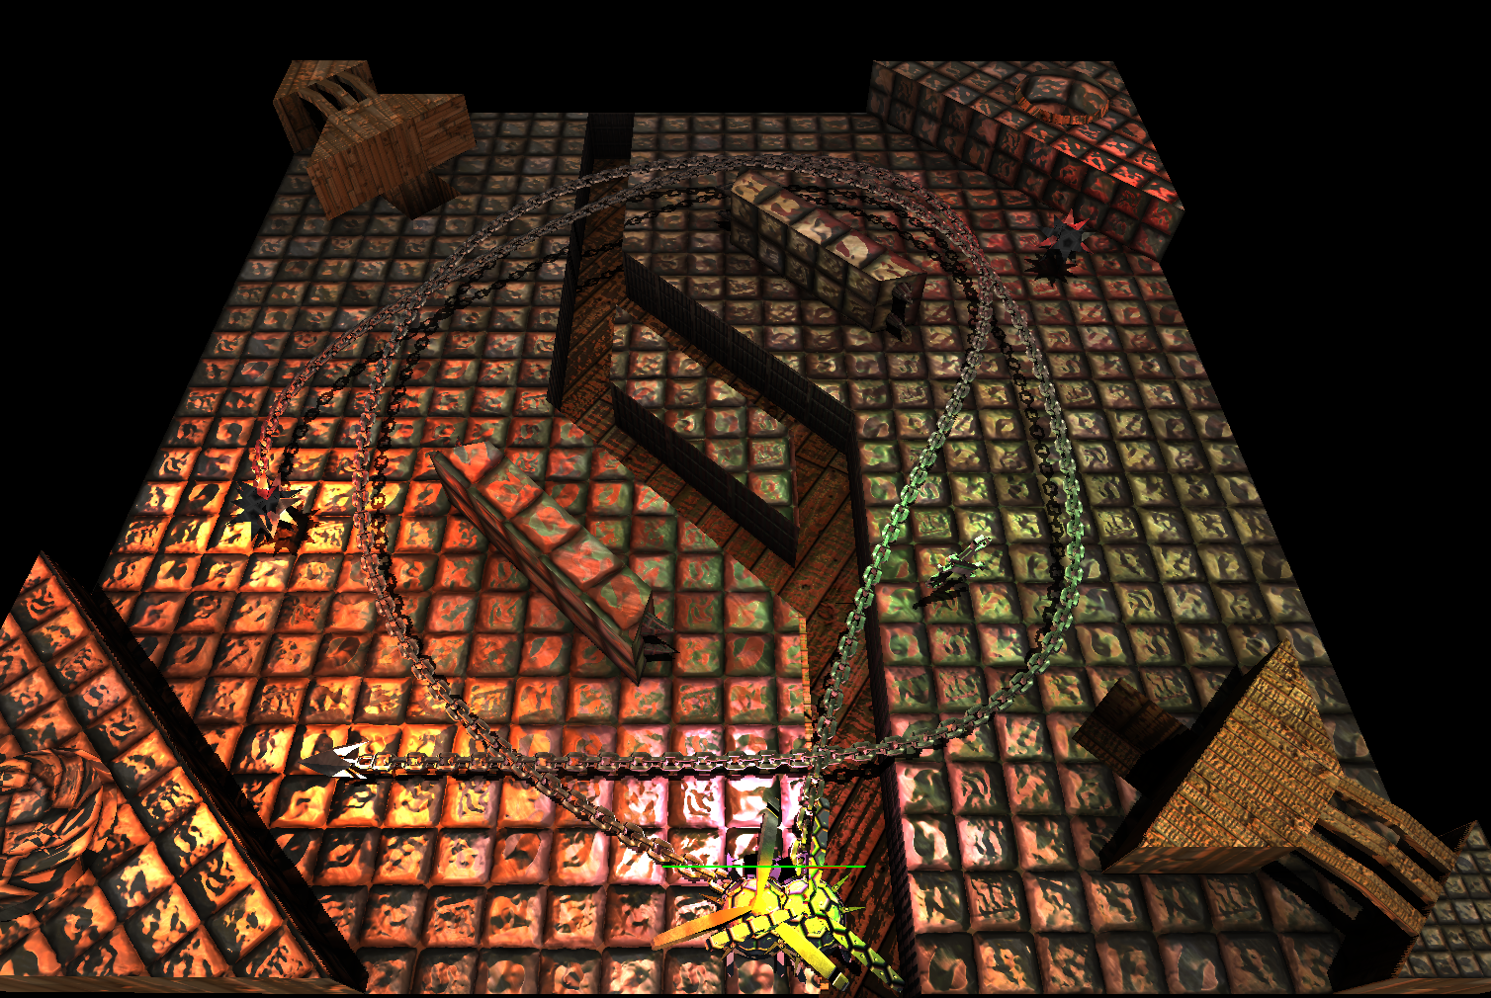
Hook Wars!

Slide 2
A Recap
We tried to re-make the Warcraft 3 custom map „Pudge Wars“ in a modern, stand-alone way
We added some nice graphical effects and gameplay elements
Hooks also behave better
Local Multiplayer is fun!

Slide 3
Gameplay Overview
2-4 players battle in a small arena
Free-for-all style Deathmatch
The goal is to kill other players using hooks and map hazards
There are both static hazards (spikes) and dynamic ones (mines)
There is a split (the „river“) across the middle of the arena that can't be walked across

Slide 4
Gameplay Details
Players also get a „Grappling Hook“ with a longer cooldown than the regular one
  Does not hit players/mines but instead moves the player towards the first piece of terrain it hits
  Can be used to move across the river
Periodically, mines and repair kits will spawn in random locations
  Mines deal damage upon contact, repair kits heal
  Both can be pulled into oneself or other players with a hook

Slide 5
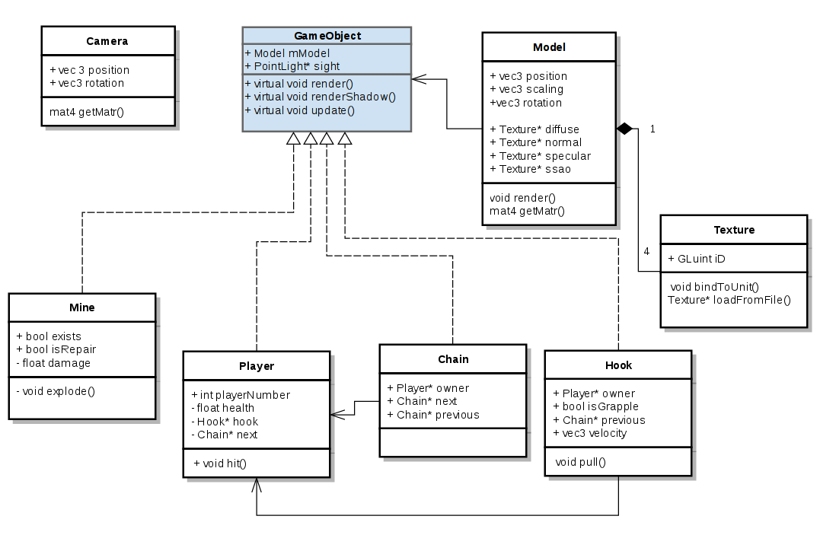
Software architecture

Slide 6
Dependencies
GLFW
GLM
GLEW
ASSIMP
LodePNG
Look ma, no ACGL!

Slide 7
On Player Control
Original game: indirect navigation
  Was a remnant of Warcraft 3's RTS mechanics
  Not very good for an arcade-style game
  Tedious to implement, needs a pathfinding algorithm
  Dependency on mouse makes local multiplayer impractical
Our idea: direct movement&aiming
  More fun and easier to pick up
  Use game pads for local multiplayer
  Optional keyboard controls are implemented too

Slide 8
On Player Control
Original game: indirect navigation
  Was a remnant of Warcraft 3's RTS mechanics
  Not very good for an arcade-style game
  Tedious to implement, needs a pathfinding algorithm
  Dependency on mouse makes local multiplayer impractical
Our idea: direct movement&aiming
  More fun and easier to pick up
  Use game pads for local multiplayer
  Optional keyboard controls are implemented too

Slide 9
Player-Terrain Collision
Map has a pre-computed, 2D collision map
  Very cheap to check for collisions in general
  No representation for angles of walls
First approach: simply stop players from moving when they collide with terrain
  Not very fun
  Easy to get „stuck“ into walls
More fun: make players slide smoothly along walls when they try to run into them
  Problem: We need the normal of the wall to do this right

Slide 10
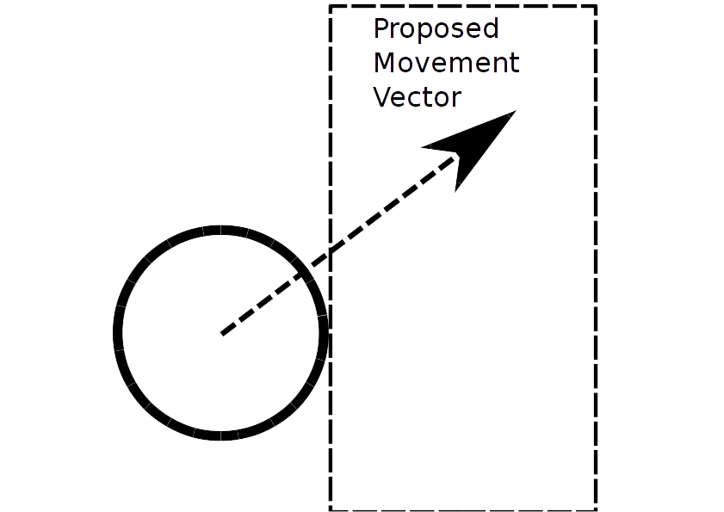
Player-Terrain Collision

Slide 11
How to get the Terrain Normal
Sample a few points around the player in a circle
Points that collide are added up
This gives a rather good estimate for the normal vector of the wall
Then, project the player's proposed movement vector along this normal
Final movement is parallel to the wall
Use the same normal for reflecting hooks off walls

Slide 12
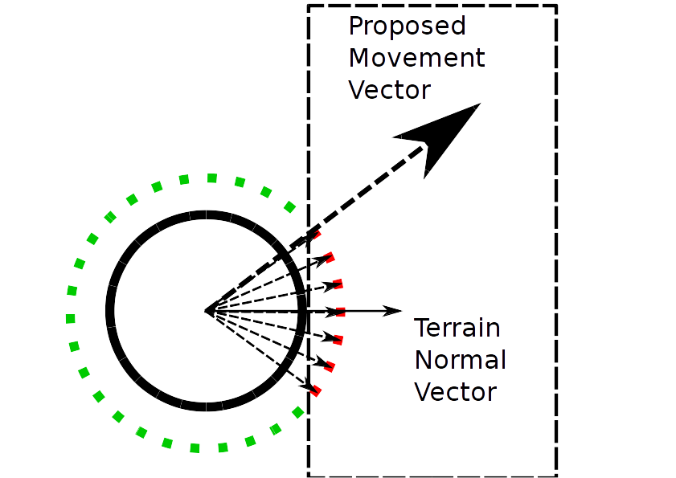
Getting the Terrain Normal Vector

Slide 13
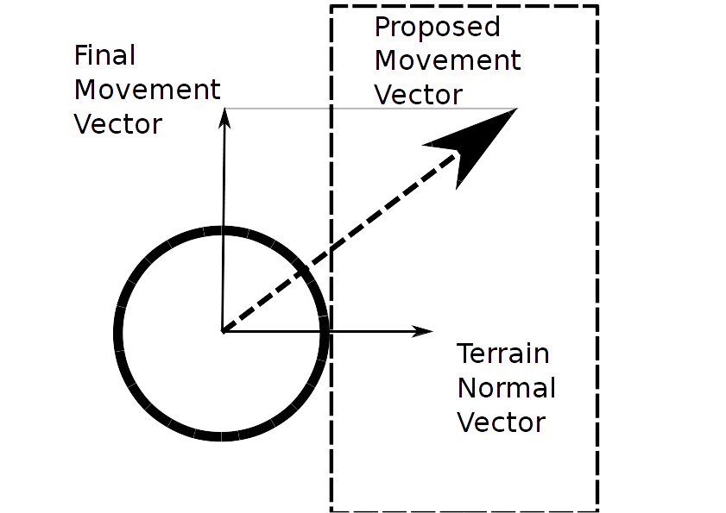
Projecting the Movement Vector

Slide 14
Chain Physics: Overview
The hook itself is simply a projectile
  Moves at a constant speed, rebounds off walls
  Just the same as in Pudge Wars
  Not physically correct but makes gameplay fun and deterministic
Chain will actually collide with and wrap around terrain objects
  This was not possible in Pudge Wars due to resource constraints

Slide 15
Chain Physics
First attempt: Rope Physics
  We tried to use existing algorithms for simulating ropes
  Move vertices according to momentum/tension first, then see if they collide with terrain and, if so, move them out of the way
  Problem: Chains are not ropes, they don't stretch or compress at all.
  This leads to chain links „bunching up“ and looking bad

Slide 16
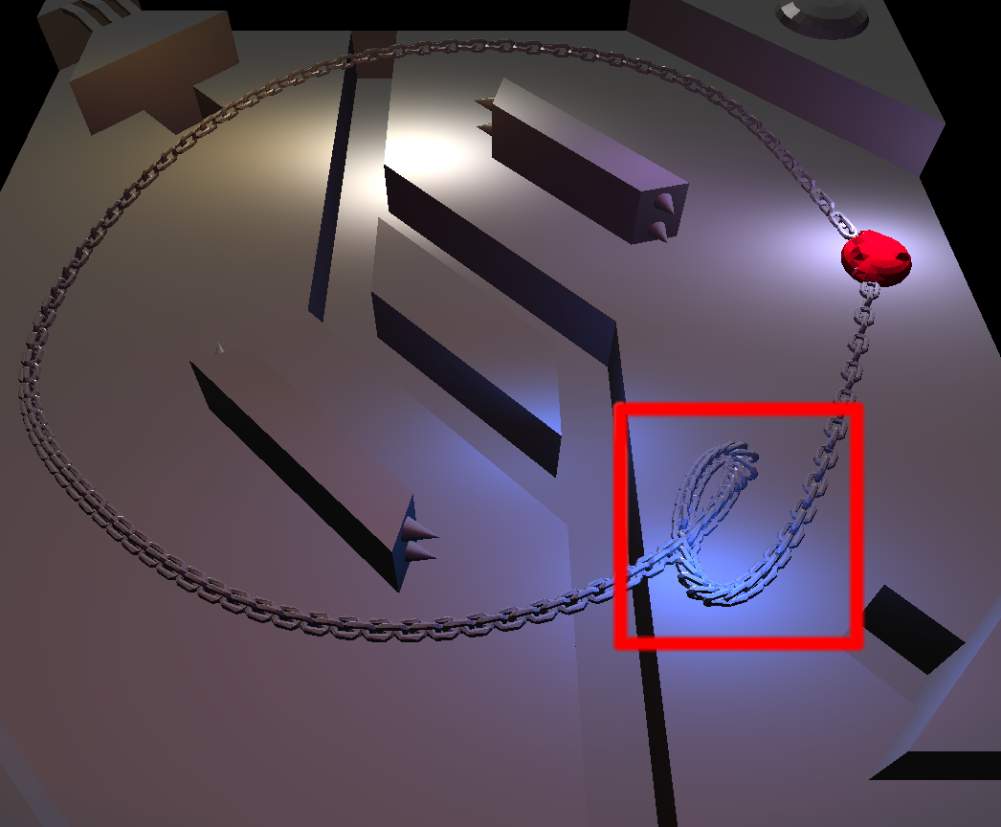
Why Rope Physics are bad

Slide 17
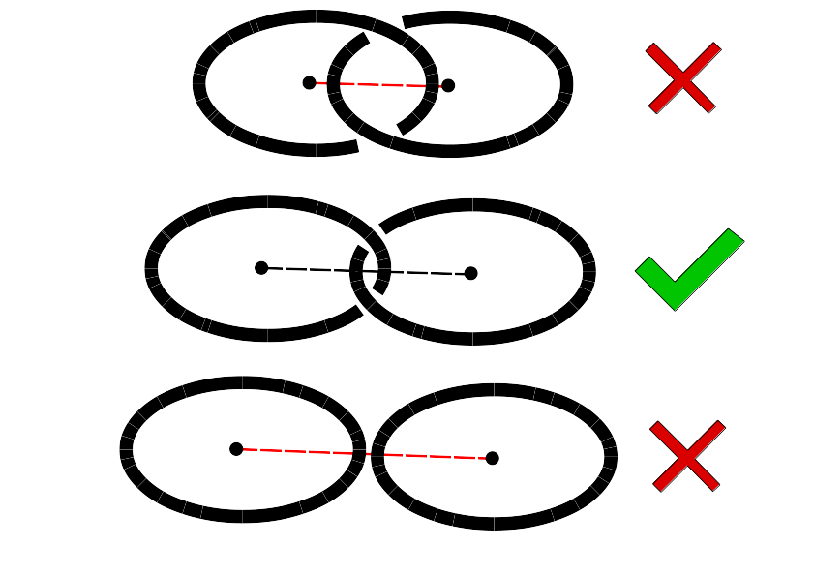
„Unbunching“ Chain Links

Slide 18
Chain Physics
Second Attempt: Keep distance constant
  Move vertices according to momentum/tension, then move them out of terrain, then „unbunch“ them
  This helps with bunching up but now chain links can move into terrain again
  Possible mitigation: Re-iterate this process a couple of times
However, we found another way

Slide 19
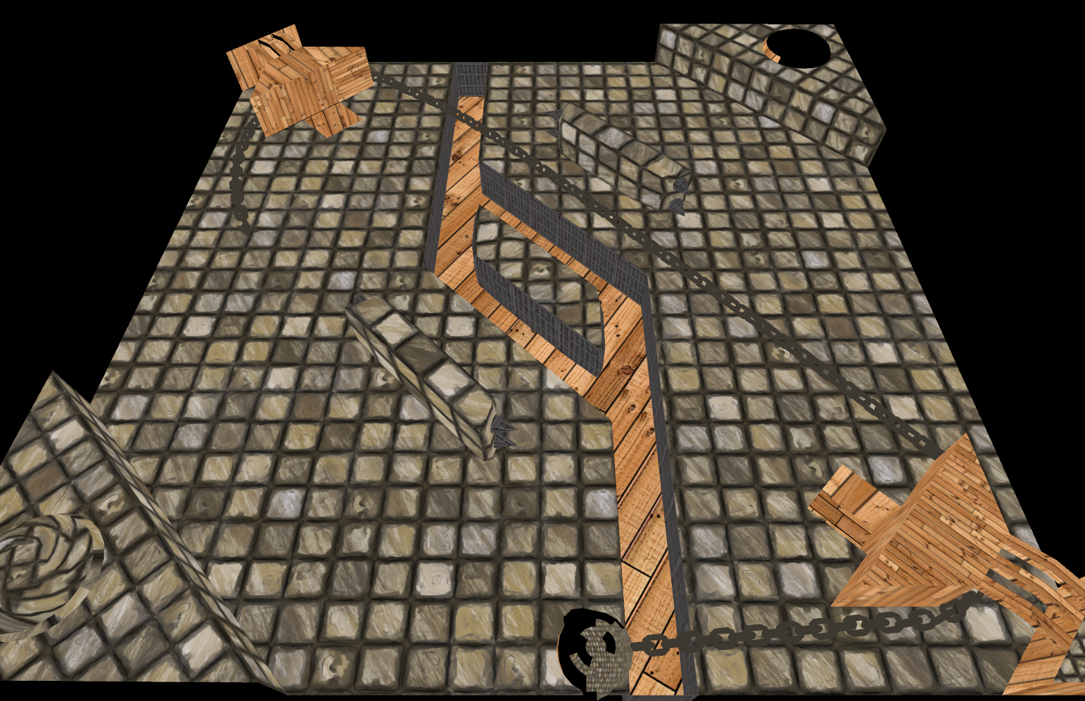
The second attempt

Slide 20
Chain Physics
Third attempt: Realize that the problem-space is one-dimensional
  We know the chain links have to end up a constant distance from one another
  Therefore, simply try out a lot of positions (64 or 128) in a circle around the next chain link
  Out of all non-colliding position candidates, pick the one closest to your preferred position

Slide 21

The Chain Problem...

Slide 22
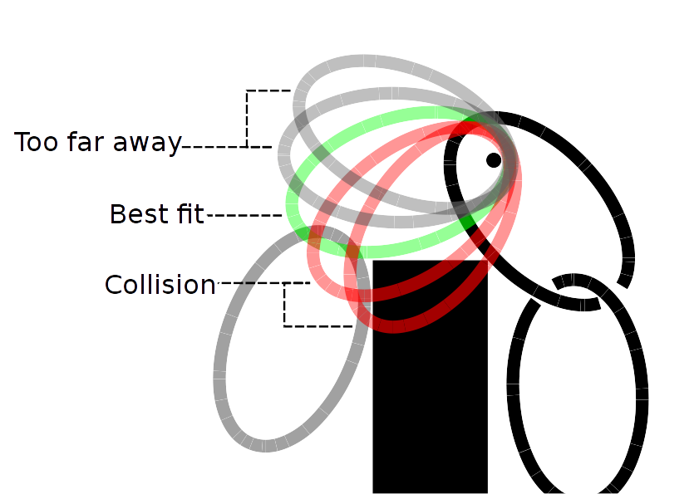
...and its solution

Slide 23
Graphical Techniques
Textures
Normal Mapping
Specular Mapping
Lighting
SSAO
Shadows

Slide 24
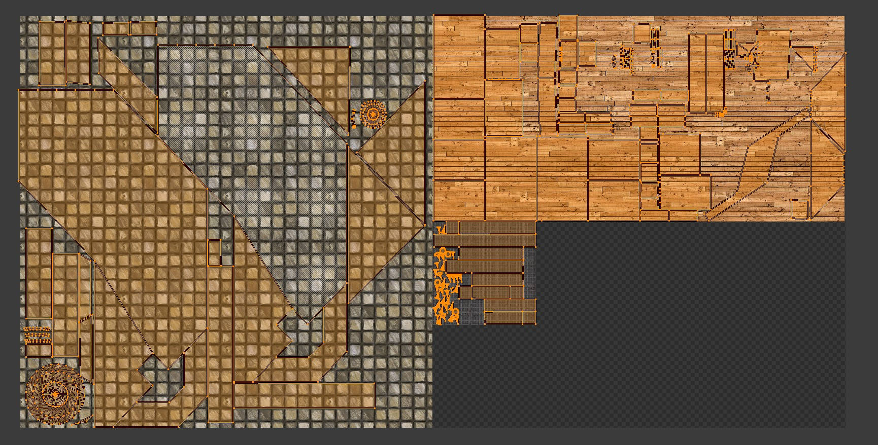
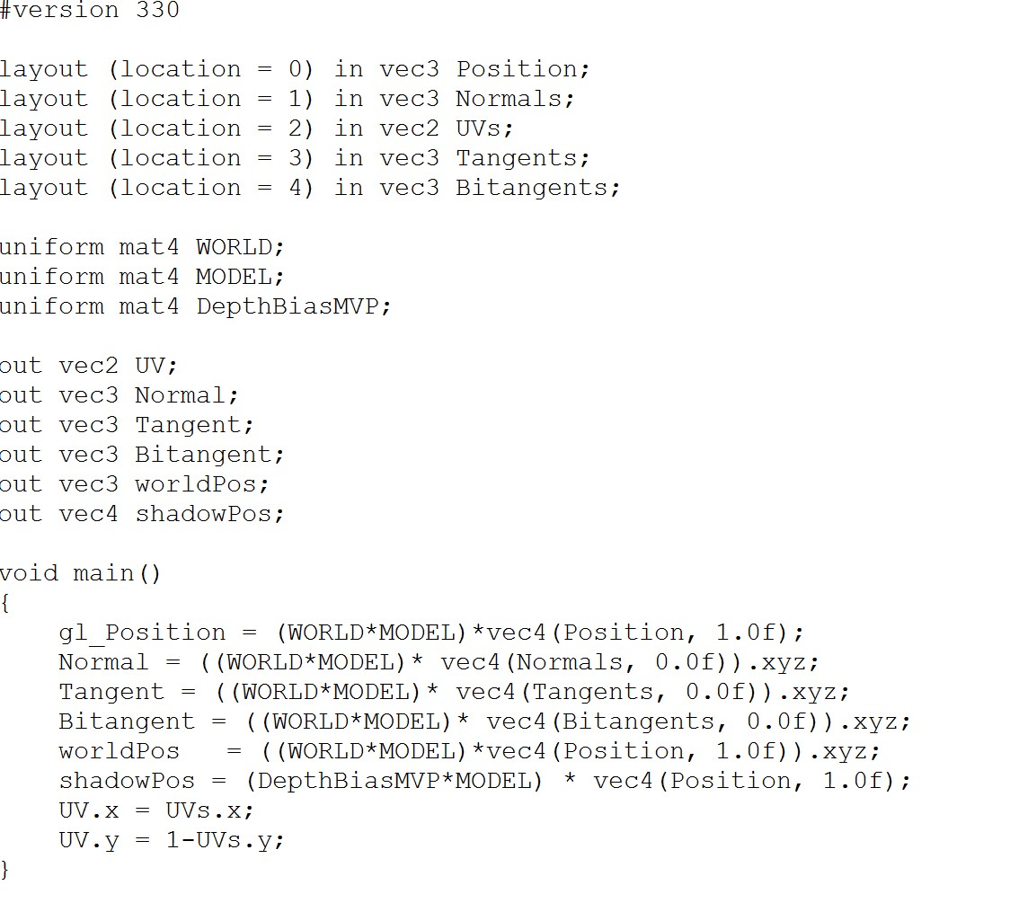

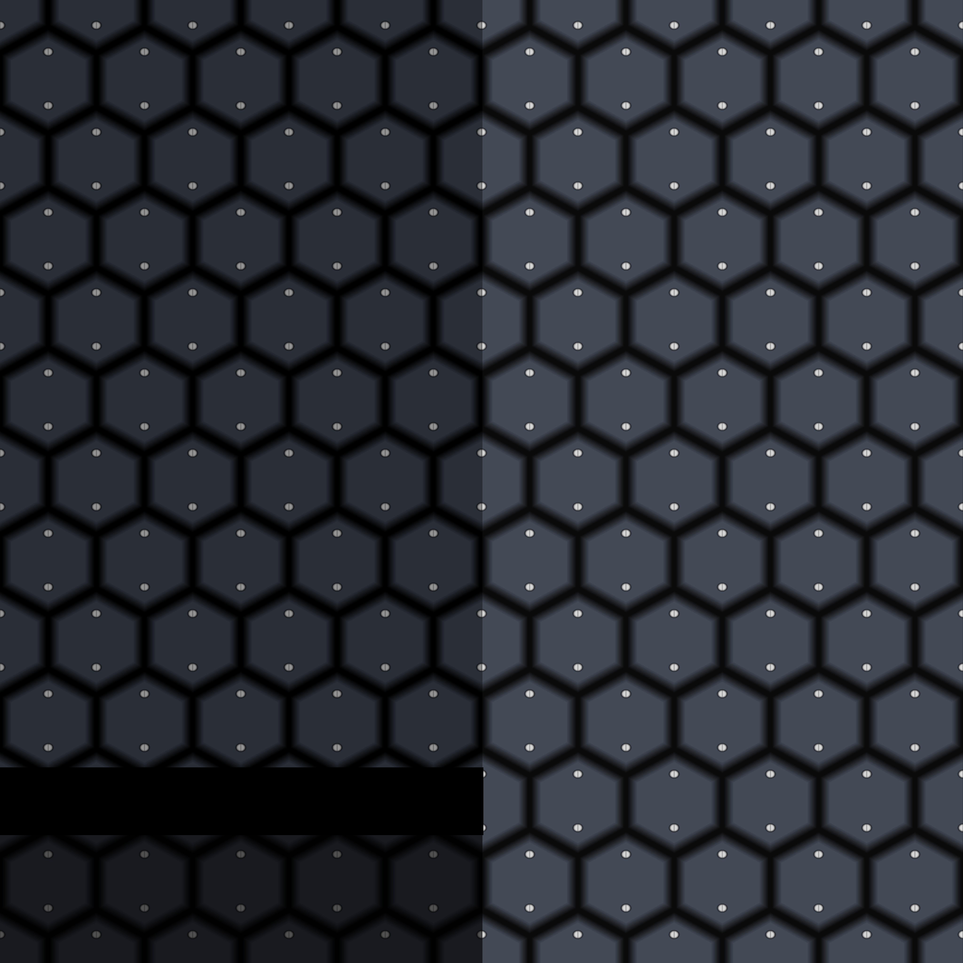
Diffuse Texture
UV unwrapped in Blender
One texture per model
Problem:
UV.y was inverted

Slide 25
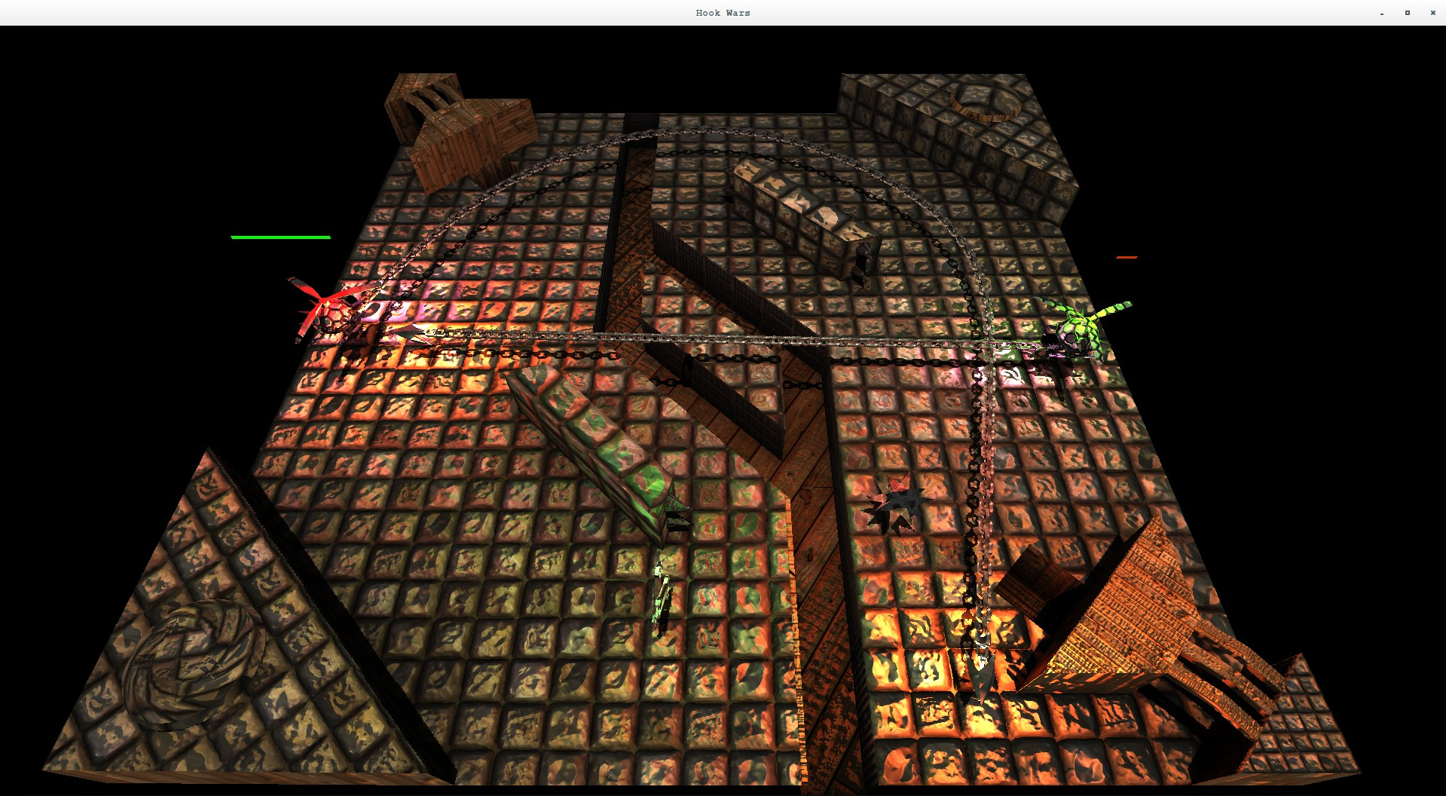
Lights
Ambient Lights
Directional Lights
Point Lights
Spotlights
Problem:
  Transforming normal vectors
  Transforming spotlight direction
Solution:
  Send projection and view matrices to shader

Slide 26
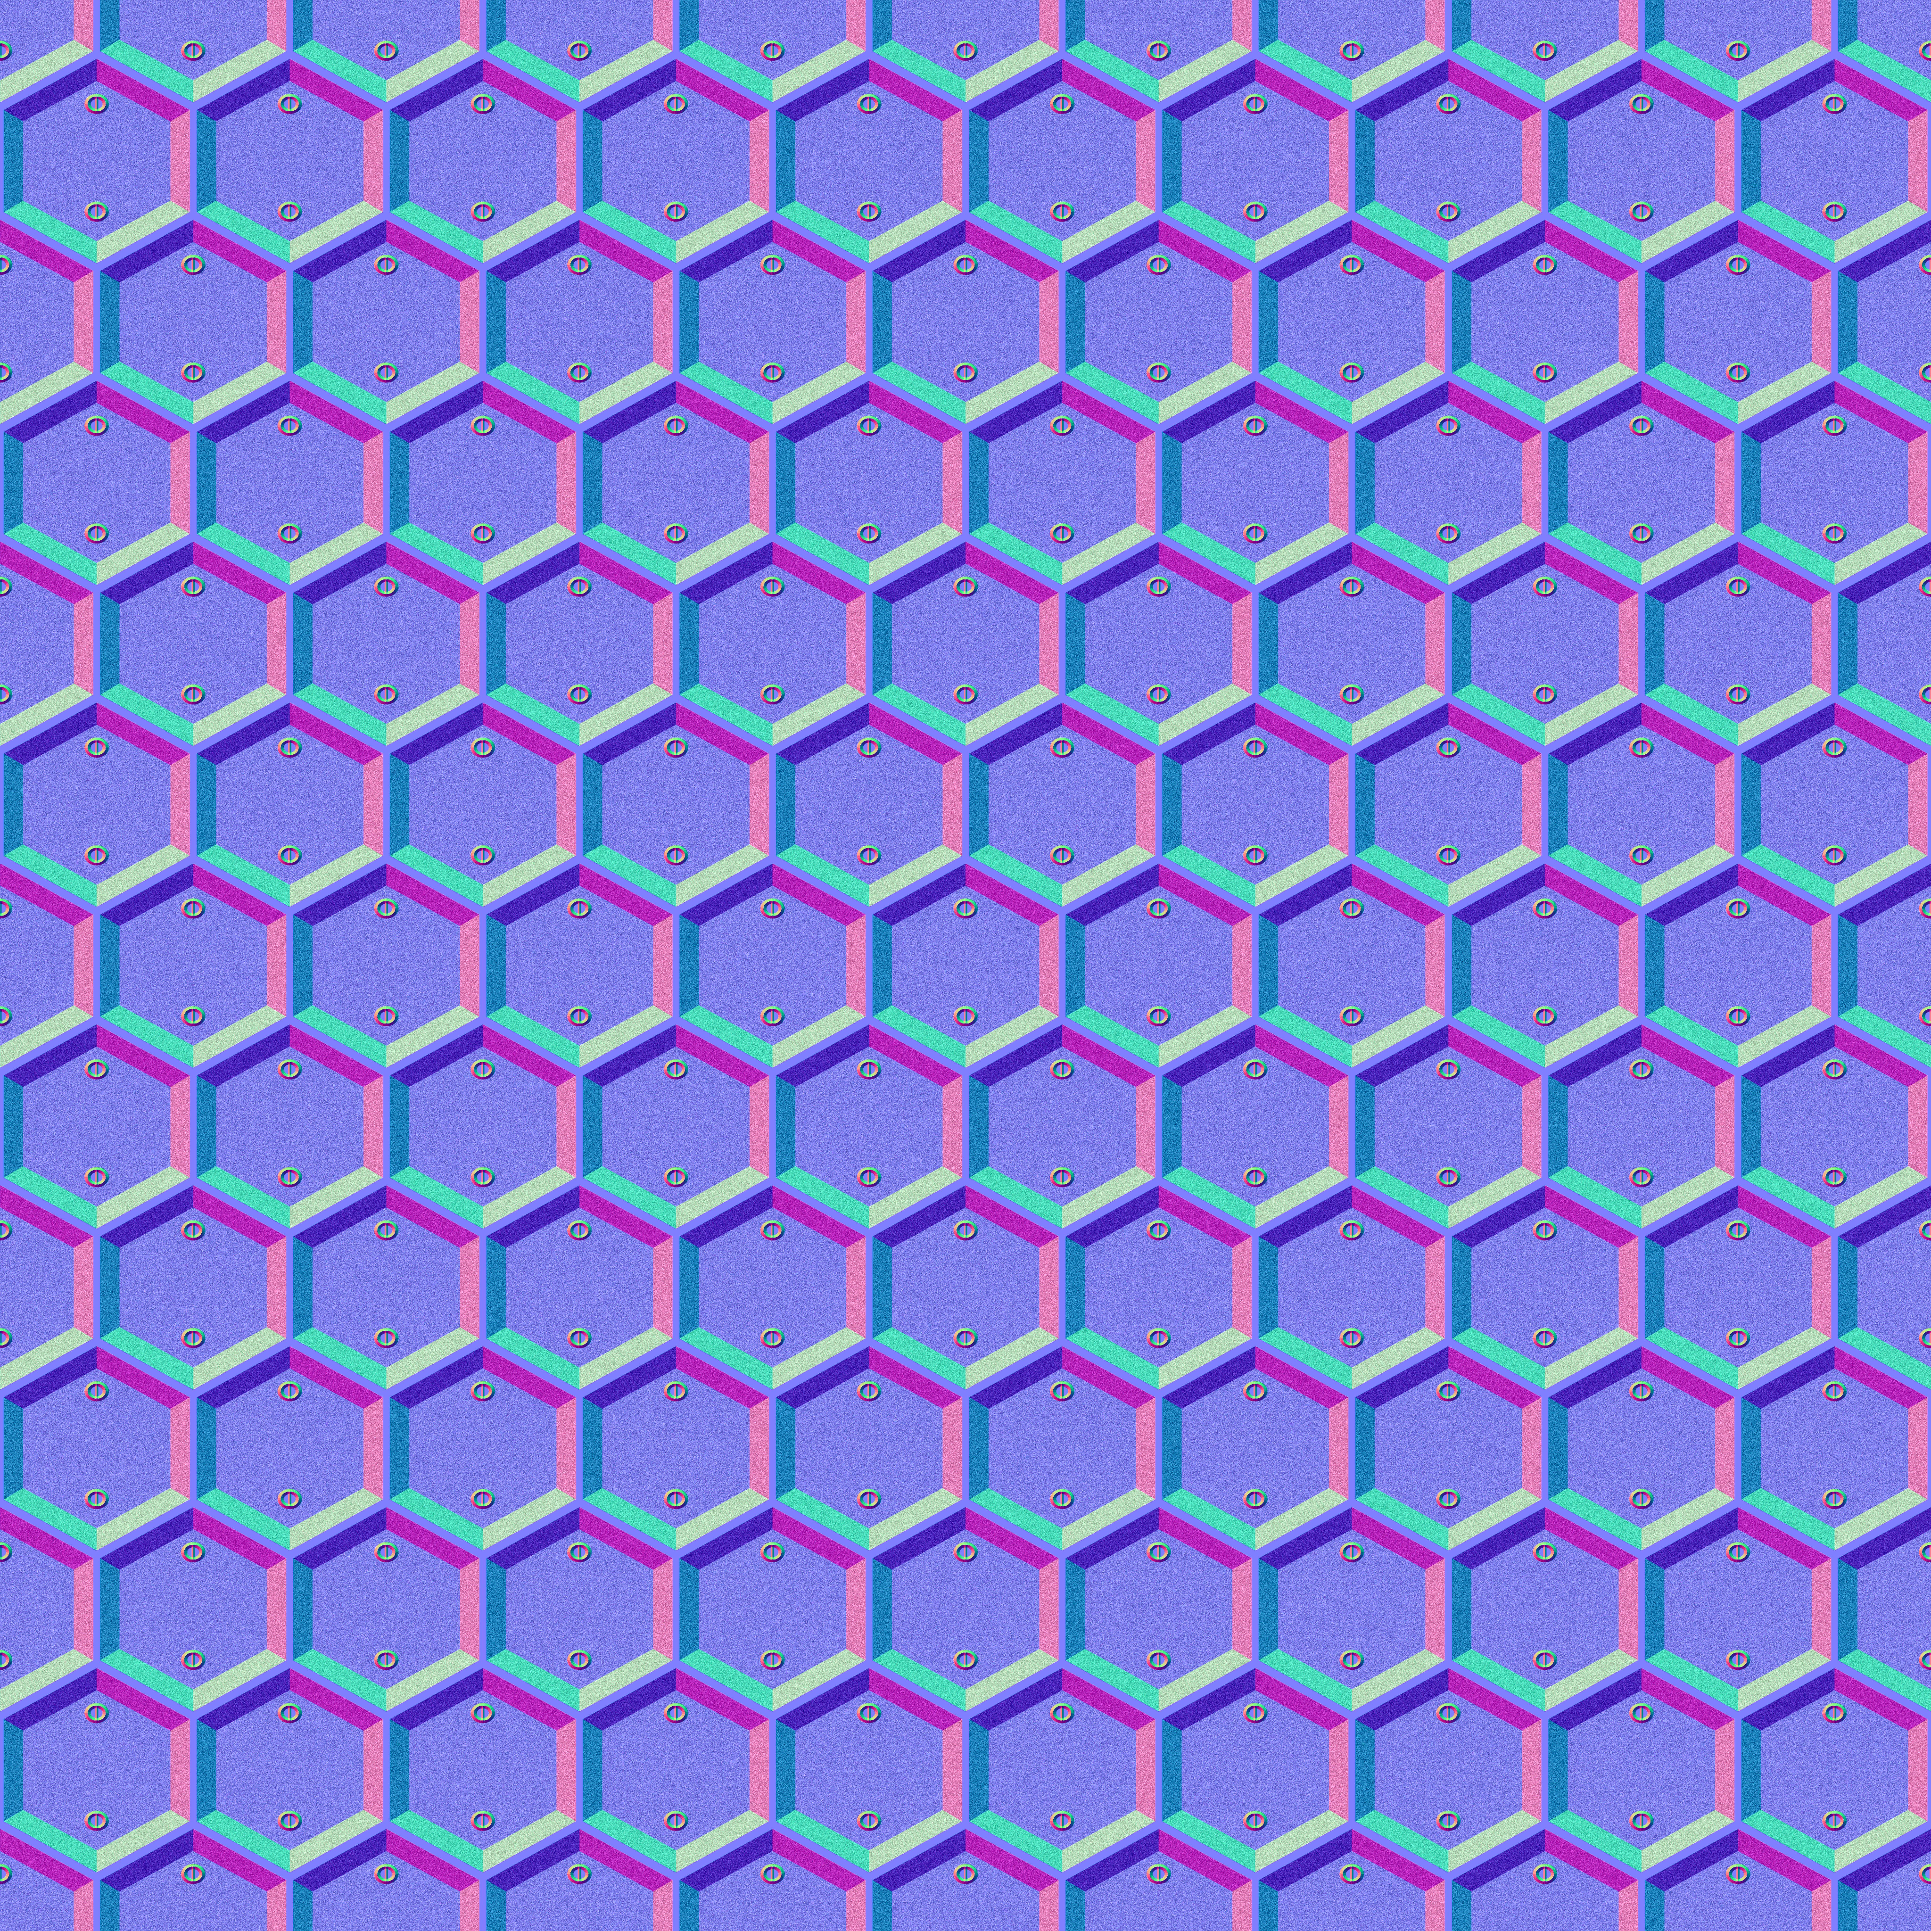
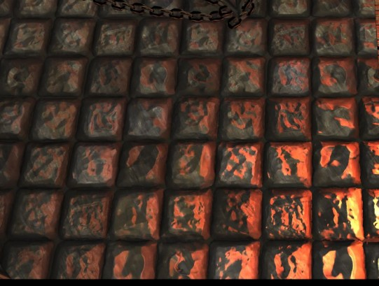
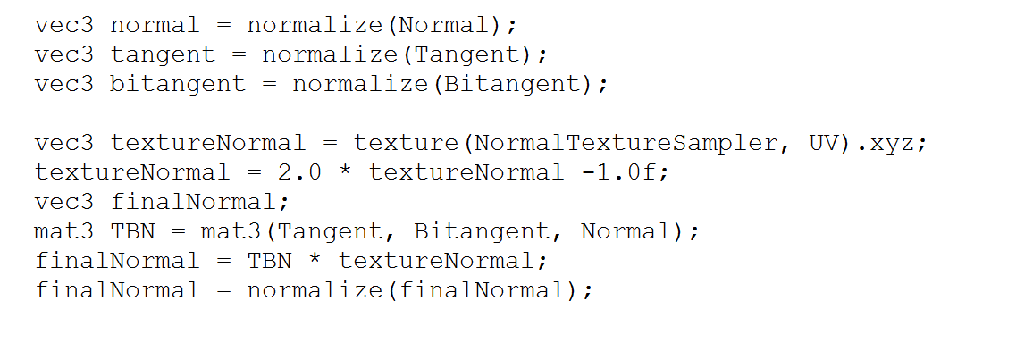
Normal Mapping
Loading from Texture
Precomputed tangent and bitangent
Resulting in an advanced normal

Slide 27
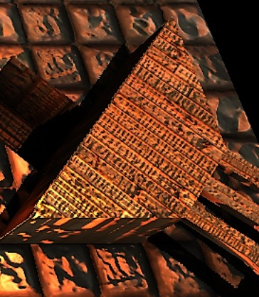
Specular Mapping
Generated from diffuse texture
Reduces „overbright“ parts

Slide 28
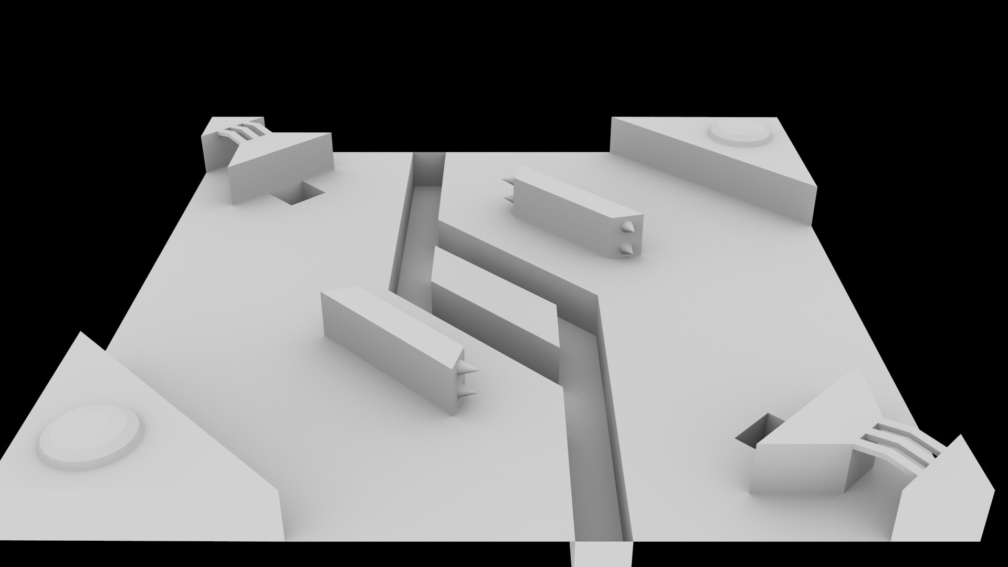
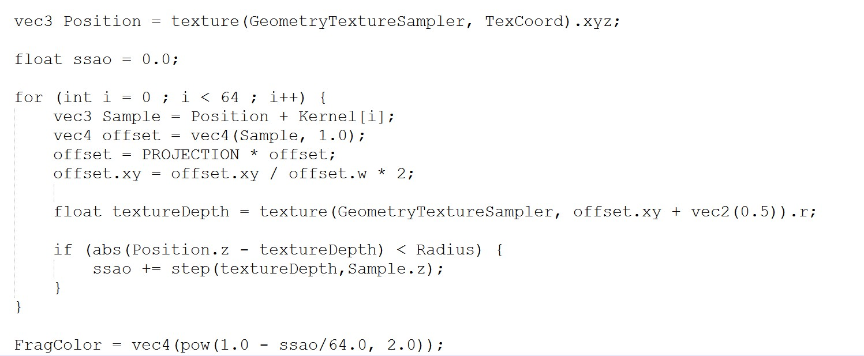

SSAO
Based on a SSAO tutorial by John Chapman.
Geometry shader
SSAO
Blur
Lighting
Problem:
Cripples the framerate to death
Never got it to work due to framebuffer issues

Slide 29
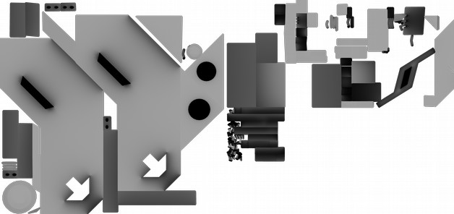
SSAO second try
One-time render to image
Transformation to texture
Sampling ssao texture
r

Slide 30
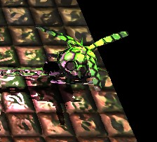

Shadows
Rendering to depth texture from a lights point of view
Problem:
  Requires framebuffer
  Did not work previously
Got the framebuffer to work
Difference between expected depth and real depth decides if there is light or not

Slide 31
Things we would have wished for
Things that slowed us down:
Spotty Blender documentation
GLSL versions differ between our computers
GLFW changed mappings between the CG-course version and „modern“ versions
Things we would do if you would tell us to redo the project right now:
Material class
Real SSAO
Intel GPU Support
Reflection / Refraction
C++ dynamic uniform mappings

Slide 32
Nice-to-haves that didn't make the cut
Multiple Maps
  A lot of tedious modeling/texturing work
  Not very challenging from a programming PoV
CTF mode
  Map is simply too small for this to be fun
Sound
  Neither of us knew how to do it

Slide 33
Conclusion
Good to work from scratch
We learned a lot:
  Don't trust any online tutorial
  Writing graphics code is different from writing mathematical code
  Assets take a lot of work
So… lets dive into the game!

